Slide 1

CAPSTONE PROJECT - 09
Quality Assurance Test Case Generation Agent
Dr. Vishwanath Kagawade
Associate Professor, Department of Artificial Intelligence and Machine Learning Basaveshwar Engineering College, Bagalkote, Karnataka, India

Slide 2
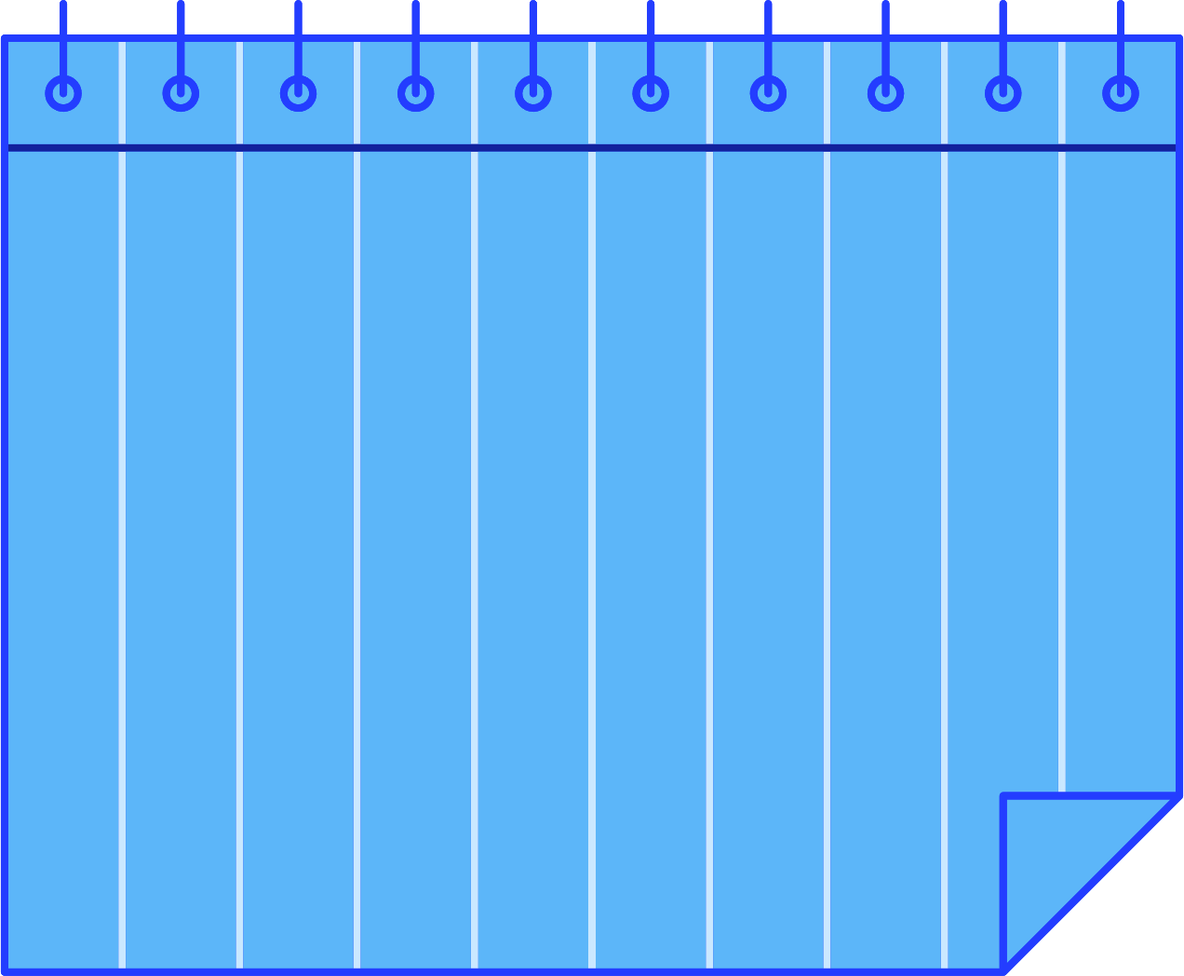
Agenda
Project business statement
Motivation/business need for the project
High level approach
Technical approach – architecture flow diagram
Technical approach – tech stack used and rationale
High-level code explanation (not exceeding one page)
Final input-output
Project ESG (environment sustainable growth factor)
Overall learning and way forward.
Actual time spent on entire project (in hrs.) – Phase wise time spent

Slide 3
1. Project Business Statement
Objective:
To develop a sustainable, AI-driven QA framework that enhances productivity, reduces manual testing workload, and contributes toward environmentally conscious software development — embodying the core principles of ESG in the field of software engineering.
Business Context:
The Industry-Ready Quality Assurance Test Case Generation Agent is an AI-driven automation framework that streamlines the test case creation process from raw application requirements and user stories. Traditional manual test design is often time-intensive, error-prone, and inconsistent, leading to delays in product validation cycles. This project addresses these challenges through intelligent automation powered by Large Language Models (LLMs) and context-aware rule-based reasoning.
The system interprets natural language requirements, classifies them into Functional, Non-Functional, or Negative types using Canonical Type Classification, and automatically generates comprehensive test artifacts—including preconditions, test steps, and expected results—using a Generic Context-Aware Preconditions Engine. A built-in Coverage Dashboard provides interactive insights, tracking test completeness and requirement coverage through visual heatmaps and summary metrics.
By integrating AI-driven interpretation with structured QA workflows, this project significantly reduces manual effort, improves consistency and coverage, and enhances productivity across quality assurance teams. It represents a sustainable, industry-ready solution for accelerating software testing processes while maintaining high quality and reliability standards.

Slide 4
2. Motivation / Business Need
In today’s fast-paced software development environment, Quality Assurance (QA) teams face increasing pressure to deliver reliable products under tight timelines. Traditional manual test case creation is labor-intensive, inconsistent, and prone to human oversight, often leading to missed scenarios and delayed releases.
As applications evolve rapidly with frequent updates and agile workflows, organizations require a scalable, intelligent, and automated approach to maintain test quality and coverage. The need for context-aware, AI-assisted test case generation arises from the growing demand to:
  Reduce manual effort and repetitive QA tasks.
  Improve accuracy and coverage in testing requirements.
  Accelerate the software validation lifecycle.
  Ensure consistency and traceability across large-scale test repositories.
  Align with modern DevOps and CI/CD practices for continuous quality.
This project fulfills that business need by leveraging AI and Natural Language Processing (NLP) to automatically interpret requirements, generate structured test cases, and provide coverage insights—making the QA process smarter, faster, and more sustainable.

Slide 5
3. High-Level Approach
1. Requirement Gathering and Input Processing
Collect user requirements either through manual input or CSV upload in the Streamlit app.
Preprocess and standardize requirement statements to ensure clarity and uniform structure.
2. AI-Powered Requirement Classification
Use NLP-based keyword and context analysis to classify requirements into:
  ✅ Functional — System behavior and features.
  🔒 Non-Functional — Performance, security, and scalability aspects.
  ❌ Negative — Error handling, invalid data, and failure scenarios.
Ensures comprehensive test coverage across all categories.
3. Context-Aware Test Case Generation
Generate structured test case components automatically:
  Description – Defines what to test.
  Preconditions – Establish required system states.
  Test Steps – Step-by-step procedure for execution.
  Expected Results – Defines the success criteria.
Leverages AI and rule-based logic to infer realistic conditions.

Slide 6
High-Level Approach cont..
4. Visualization and Analysis
Compute summary metrics for each requirement (coverage %).
Display insights using a visual dashboard with:
  Heatmaps of coverage per requirement.
  Distribution of Functional / Non-Functional / Negative cases.
Helps QA teams analyze quality coverage and identify missing scenarios.
5. Export and Documentation
Allow one-click export to CSV/Excel for integration with QA workflows.
Provide versioned test case documentation for auditing and traceability.
6. Automation and Continuous Improvement
System designed for iterative enhancement through AI feedback loops.
Future updates can incorporate self-learning mechanisms and integration with enterprise QA tools (e.g., JIRA, TestRail).

Slide 7
4. Technical Approach – Architecture Flow
Layer | Component | Description
Input Layer | Streamlit UI | Captures manual or uploaded requirements.
 | CSV Reader | Loads requirements from structured files.
Processing Layer | Requirement Classifier | Detects Functional / Non-Functional / Negative intent.
 | Preconditions Generator | Context-based reasoning using keyword mapping.
 | Test Case Auto-Filler | Generates all fields (Description, Steps, Expected Result).
 | Negative Case Handler | Ensures presence of invalid input tests.
Output Layer | Dashboard Visualizer | Displays heatmap and statistics using Seaborn/Matplotlib.
 | Export Manager | Saves structured test cases in CSV and Excel formats.

Slide 8
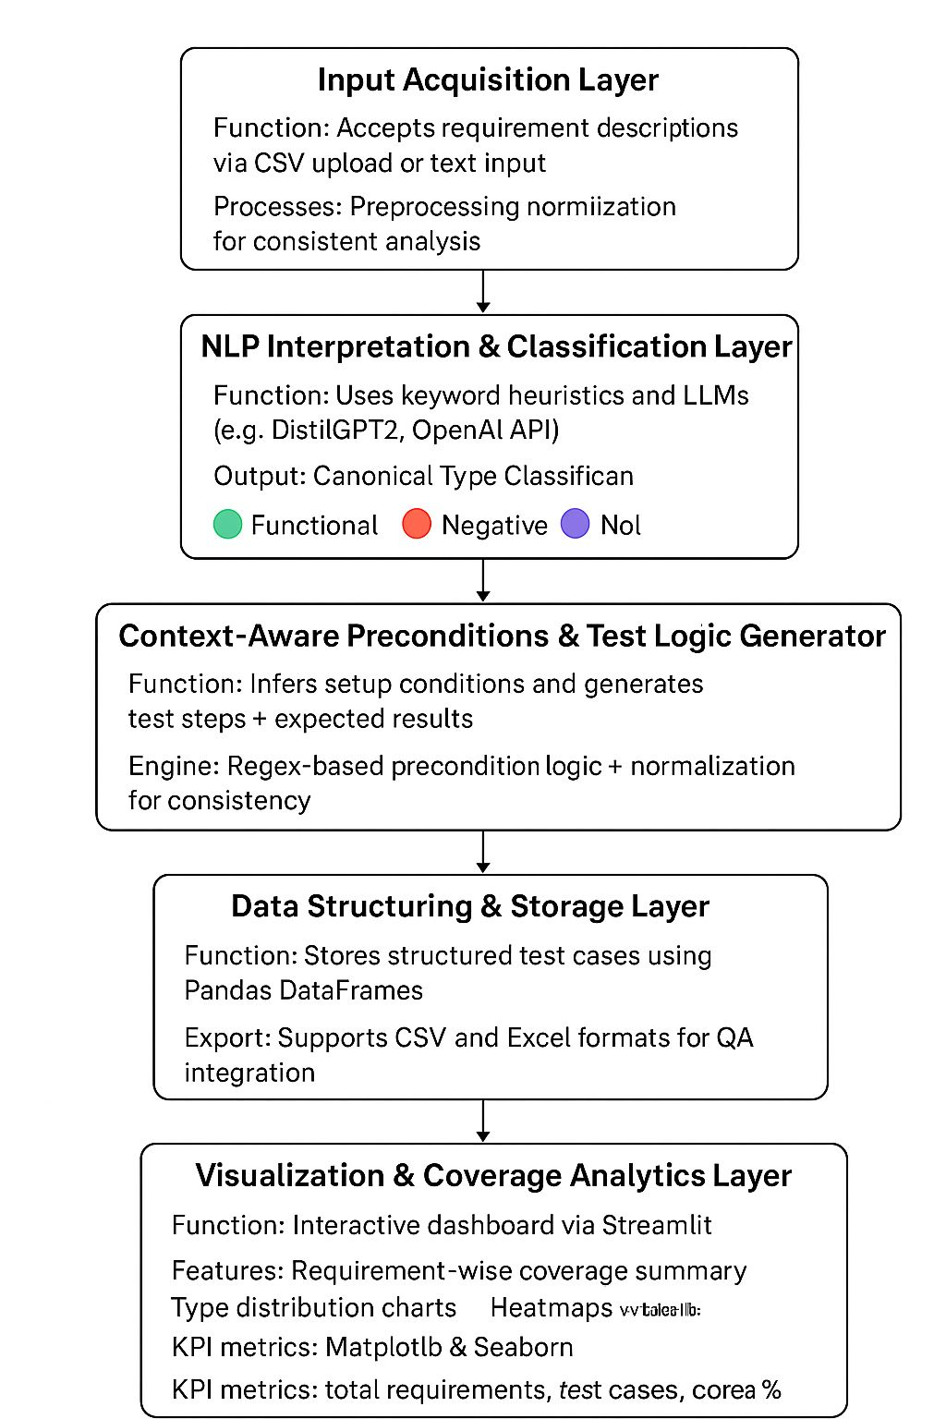
Technical Approach – Architecture Flow cnt…
Architecture Flow Of Quality Assurance Test Case Generation Agent

Slide 9
Technical Approach – Architecture Flow cnt…
The Industry-Ready Quality Assurance Test Case Generation Agent follows a modular AI-driven architecture that combines requirement interpretation, intelligent classification, and automated test generation with interactive visualization and reporting.
1. Input Acquisition Layer
Accepts requirement descriptions or user stories via CSV upload or text input.
Preprocesses and normalizes text for consistent analysis.
2. NLP Interpretation & Classification Layer
Uses keyword-based heuristics and Large Language Model (LLM) capabilities (e.g., DistilGPT2 / OpenAI API) to interpret requirement semantics.
Performs Canonical Type Classification into:
  🟢 Functional
  🔴 Negative
  🟣 Non-Functional
Ensures linguistic context is preserved for accurate test generation.
🔍 3. Context-Aware Preconditions & Test Logic Generator
Implements a Generic Context-Aware Preconditions Engine that dynamically infers relevant preconditions, setup details, and environment dependencies.
Automatically generates test steps and expected results aligned with the classified requirement type.
Applies normalization to ensure completeness and consistency across all generated cases.

Slide 10
Technical Approach – Architecture Flow cnt…
📊 4. Data Structuring & Storage Layer
Organizes generated outputs into structured formats using Pandas DataFrames.
Supports export in CSV and Excel formats for QA integration.
🧾 5. Visualization & Coverage Analytics Layer
Provides an interactive Streamlit dashboard for:
  Requirement-wise test coverage summary
  Functional vs. Non-Functional vs. Negative distribution
  Visual heatmaps using Matplotlib and Seaborn for requirement coverage tracking
Displays KPI metrics such as total requirements, total test cases, and coverage percentage.
☁6. Integration & Deployment Layer
Built using Streamlit for web-based interaction and deployment.
Optionally integrates OpenAI API for enhanced natural language generation.
Lightweight and scalable for real-time QA assistance in continuous integration pipelines.

Slide 11
5.Technical Approach – Tech Stack & Rationale
Component | Technology | Rationale / Purpose
Frontend (User Interface) | Streamlit | Enables quick and interactive web-based interface for requirement input, dashboard visualization, and CSV/Excel downloads. Minimal setup with Python integration.
Backend Processing | Python 3.x | Core programming language for all data handling, NLP logic, and ML integration. Provides rich ecosystem for AI/ML and data processing.
Natural Language Processing (NLP) Engine | OpenAI GPT / Hugging Face Transformers | Generates descriptive test cases, interprets natural-language requirements, and performs intelligent classification of Functional, Non-Functional, and Negative test cases.
Data Handling & Transformation | Pandas | Simplifies manipulation of CSV/Excel data, merging, and cleaning during requirement-to-test-case generation workflow.
Visualization | Matplotlib & Seaborn | Used to create heatmaps and bar charts to show test coverage percentage, case distribution, and overall progress visually.
Storage & Export | CSV / ExcelWriter (OpenPyXL) | Ensures generated test cases can be downloaded and shared in universally accepted QA documentation formats.
AI-Oriented Preprocessing | Regex / Custom Keyword Parser | Extracts and interprets contextual cues from requirements (like “login,” “update,” or “payment”) for precondition and step generation.
Environment Management | dotenv (.env) | Secures sensitive credentials (e.g., OpenAI API key) and allows flexible deployment configurations.
Visualization Frontend Enhancements | Streamlit Components & Charts | For user-friendly dashboards and data exploration (heatmap, coverage %, total case count, etc.).

Slide 12
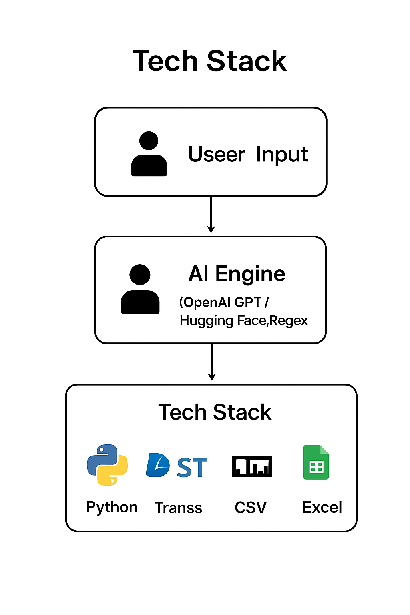
Technical Approach – Tech Stack & Rationale

Slide 13
6. High-Level Code Explanation
Algorithmic Pseudocode
1. Load configurations, environment, and model.
2. Display Streamlit interface.
3. Get user input (CSV or manual).
4. For each requirement:
a. Classify requirement (Functional/Non-Functional/Negative)
b. Generate preconditions based on keywords
c. Auto-fill description, steps, and expected results
d. Assign unique Test Case ID
e. Add to DataFrame
f. If negative case missing → generate synthetic one
5. Concatenate all test cases into final dataset
6. Compute coverage metrics
7. Plot heatmap visualization
8. Export results to CSV and Excel
9. Display interactive dashboard

Slide 14
High-Level Code Explanation cont…
High-Level Code Explanation
1. Input Handling
Accepts manual text input or CSV upload containing requirement statements.
Uses Streamlit interface for user-friendly input and real-time feedback.
Each requirement is validated, cleaned, and stored in a Pandas DataFrame.
uploaded_file = st.file_uploader("Upload CSV", type=["csv"]) if uploaded_file: df = pd.read_csv(uploaded_file) else: user_input = st.text_area("Enter requirements manually")
2. Requirement Classification
Each requirement is classified as:
  Functional
  Non-Functional
  Negative / Error Handling
Classification uses keyword-based NLP logic for contextual detection.
def classify_requirement(req): if any(word in req.lower() for word in ["error", "invalid", "fail"]): return "Negative" elif any(word in req.lower() for word in ["performance", "secure", "availability"]): return "Non-Functional" else: return "Functional"
3. Context-Aware Preconditions Generation
Dynamically generates realistic preconditions by analyzing verbs and contexts such as login, payment, upload, etc.
Example:
  “Login” → User must have valid credentials.
  “Payment” → Payment gateway should be active.
def generate_preconditions(requirement): if "login" in requirement.lower(): return "User must have valid credentials." elif "payment" in requirement.lower(): return "Payment gateway must be configured." return "System and required modules should be operational."
4. Automatic Test Case Generation
Fills all fields:
  Description
  Preconditions
  Test Steps
  Expected Result
Generates negative test cases automatically if missing.
def generate_test_case(req, label): return { "Description": f"Verify {req.lower()} works as expected.", "Preconditions": generate_preconditions(req), "Test Steps": "1. Launch app\n2. Perform operation\n3. Verify output", "Expected Result": "System behaves as expected." }
5. Dashboard Visualization
Summarizes generated test cases by category.
Plots a coverage heatmap using Seaborn and Matplotlib.
summary = df["Type Label"].value_counts() sns.heatmap(data=summary.to_frame().T, annot=True, cmap="Blues")
6. Output Generation
Final test cases exported to:
  CSV → for automation integration
  Excel → for QA documentation

Slide 15
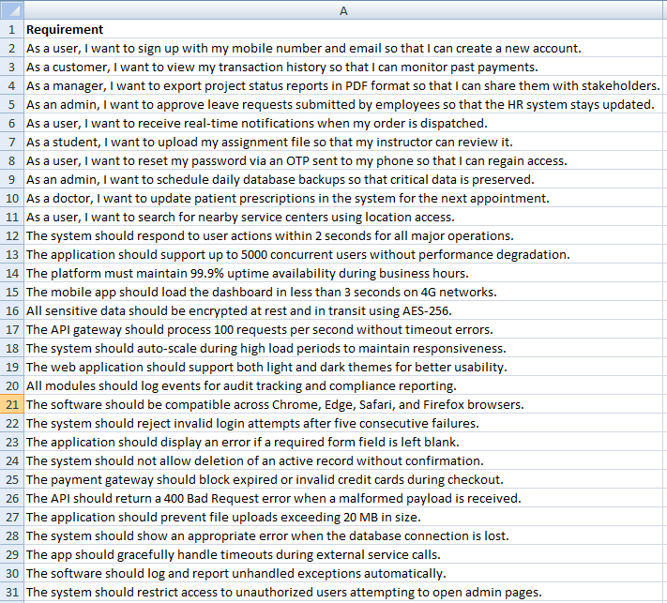
7. Final Input-Output
Sample Input

Slide 16
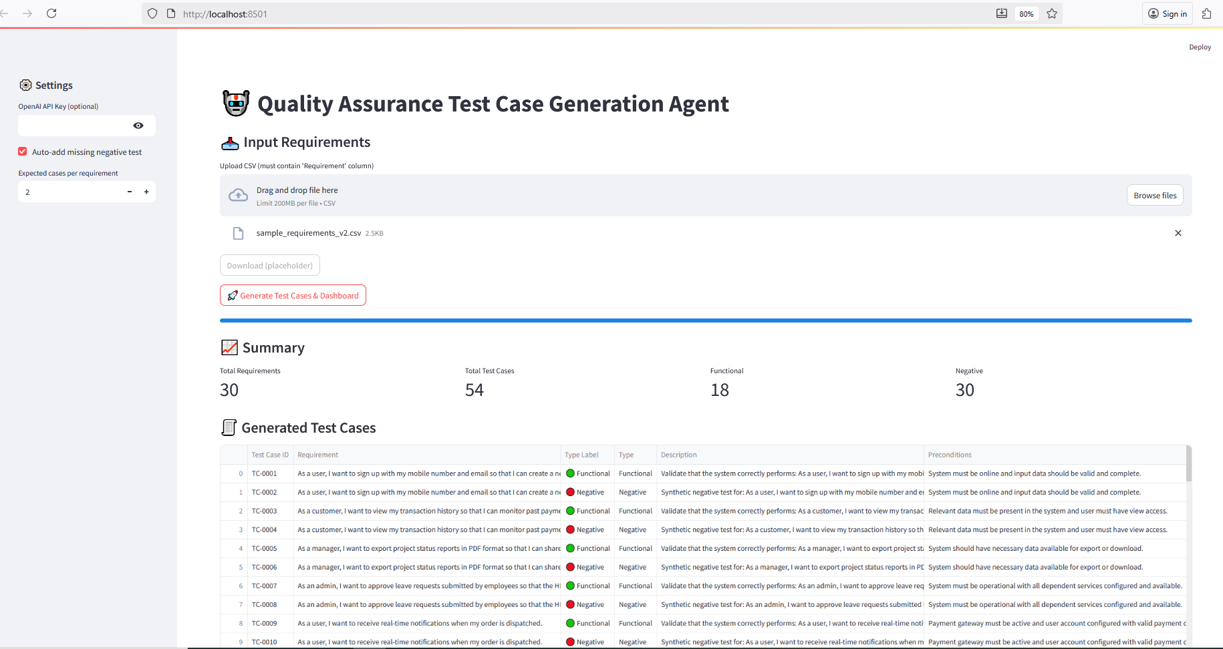
Final Input-Output cnt…
Output in Dashboard

Slide 17
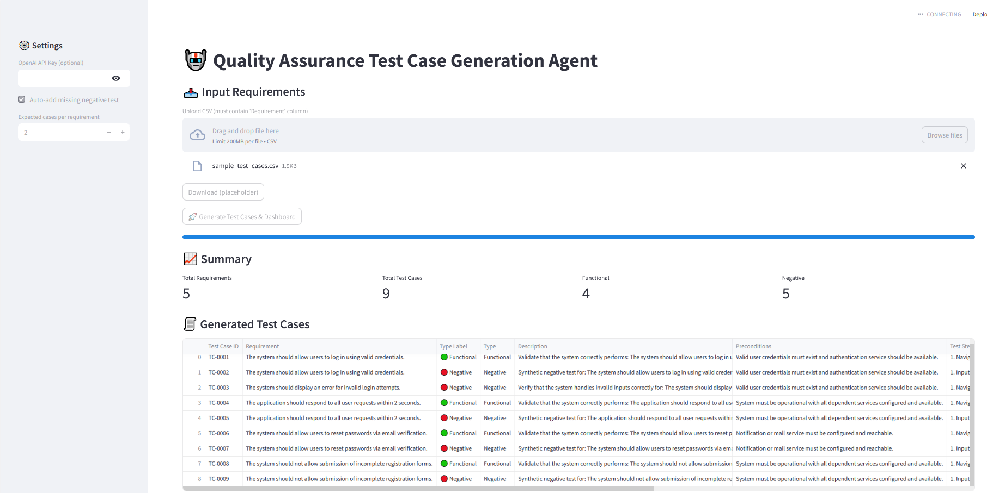
Final Input-Output cnt…
Output in Dashboard

Slide 18
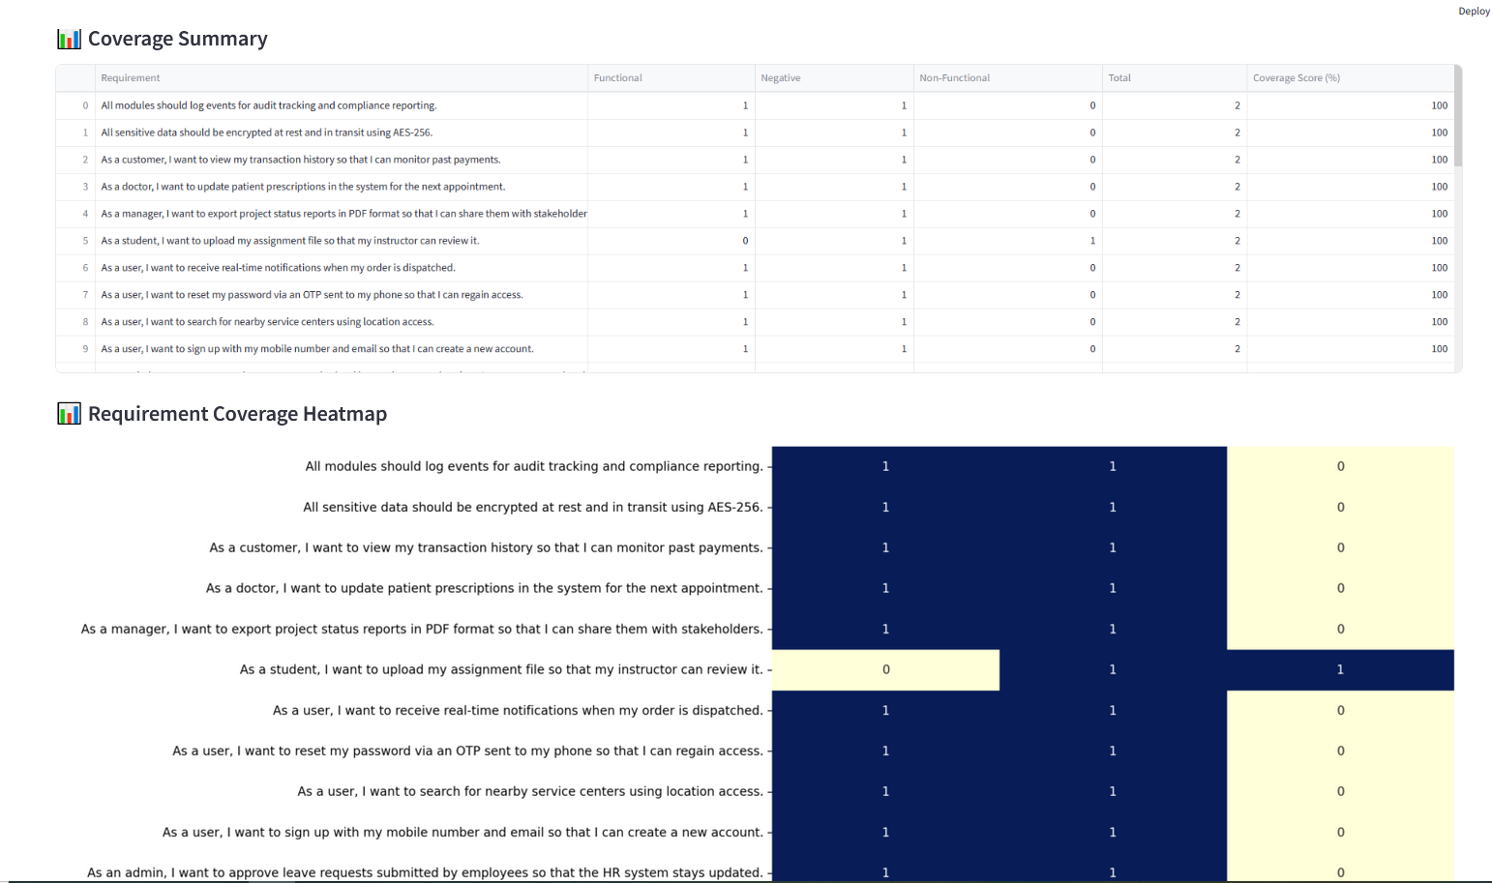
Final Input-Output cnt…
Output in Dashboard

Slide 19
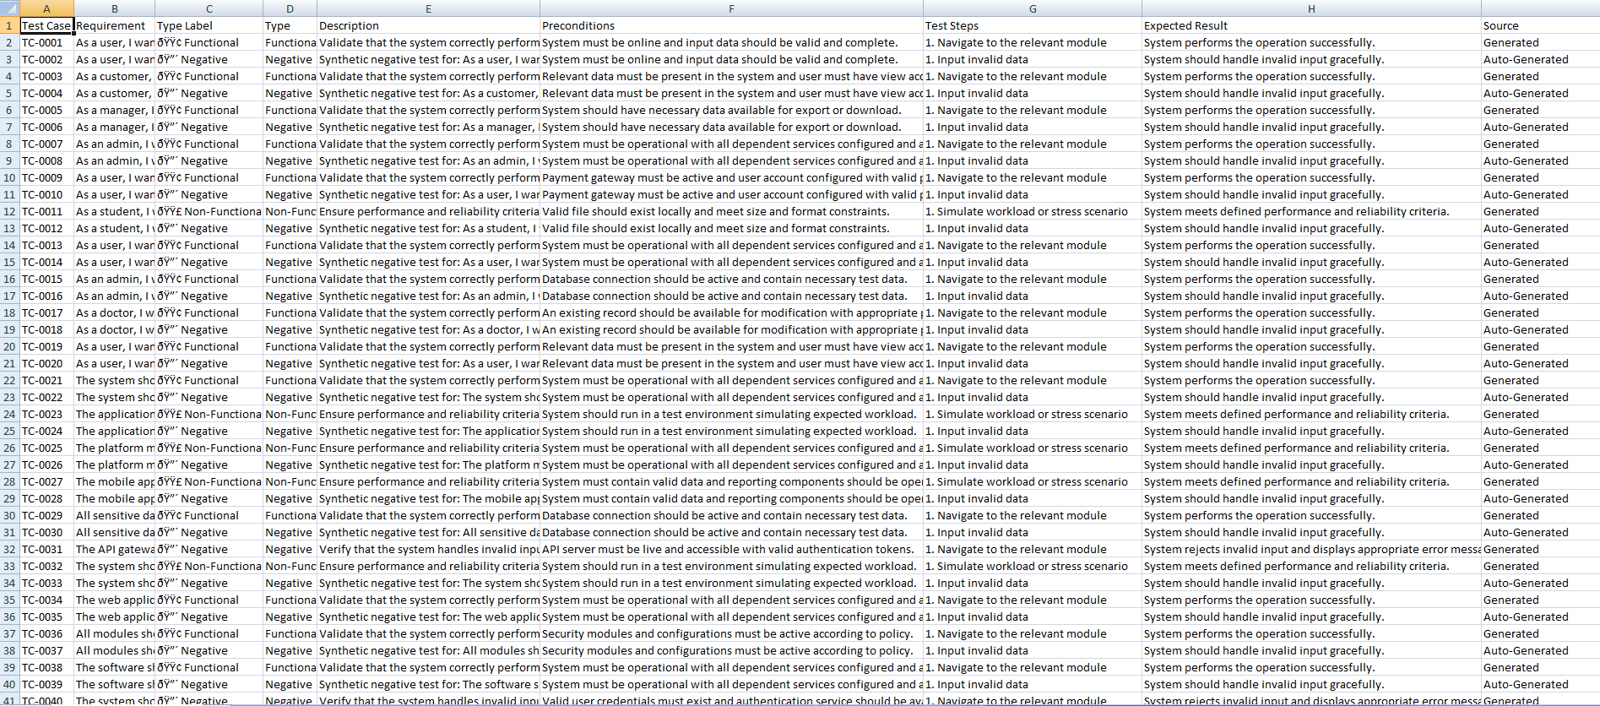
Final Input-Output cnt…
Sample Output in Excel sheet

Slide 20
8. Project ESG (Environment Sustainable Growth Factor)
Project ESG (Environment Sustainable Growth Factor) aims to revolutionize the software quality assurance process by integrating AI-driven automation with sustainable digital development practices. The project addresses the growing industry demand for faster, more reliable, and environmentally conscious testing solutions.
By automating the generation, classification, and validation of test cases from natural language requirements, Project ESG significantly reduces manual effort, minimizes testing cycle time, and optimizes computational resource usage. This not only improves organizational efficiency and product reliability but also aligns with ESG goals by promoting green software engineering practices—lowering energy consumption, eliminating redundancy, and enhancing traceability and governance in QA workflows.
Ultimately, the project supports businesses in achieving sustainable growth, maintaining regulatory and quality compliance, and accelerating digital transformation while remaining environmentally responsible.

Slide 21
9. Overall Learning and Way Forward
Key Learning
Understanding AI in QA Automation
  Learned how Natural Language Processing (NLP) can transform unstructured requirements into structured test cases.
  Gained insight into prompt engineering and context-based response generation using OpenAI/Hugging Face models.
Practical Exposure to Software Engineering Practices
  Implemented an end-to-end software pipeline involving data ingestion, AI processing, and visualization.
  Applied modular design principles — separating UI, logic, and visualization layers.
Visualization and Analytics
  Learned to interpret QA coverage through heatmaps, metrics summaries, and dashboards.
  Used tools like Matplotlib and Seaborn to convey insights effectively.
Automation and Efficiency
  Achieved automation of repetitive QA tasks such as test case writing and requirement validation.
  Improved understanding of how AI can reduce manual testing effort, leading to time and cost savings.
Technical Skill Development
  Strengthened skills in Python, Streamlit, Pandas, NLP frameworks, and data visualization.
  Improved ability to integrate multiple AI and data tools into a unified product.

Slide 22
Overall Learning and Way Forward cnt…
Way Forward
Integration with Industry QA Tools
  Connect with JIRA, TestRail, or Azure DevOps for seamless requirement and test case synchronization.
Enhanced Intelligence
  Incorporate LLM fine-tuning for domain-specific vocabulary (e.g., healthcare, finance, education).
  Add semantic similarity matching to link requirements with corresponding test cases automatically.
Voice and Multilingual Input Support
  Extend to accept voice commands and multi-language requirement inputs (Kannada, Hindi, etc.) using speech recognition and translation APIs.
Continuous Learning Framework
  Enable system to learn from user feedback, improving test case accuracy over time.
Scalable Cloud Deployment
  Deploy on cloud (e.g., AWS, Azure, Streamlit Cloud) for real-time accessibility and team collaboration.
AI Governance & Ethical Practices
  Ensure transparency, fairness, and data security in AI decision-making — aligning with ESG goals.

Slide 23
Overall Learning and Way Forward cnt…
Learning Outcomes
  • AI-driven QA automation insights.
  • NLP-based requirement understanding.
  • Streamlit dashboard design.
Future Work
  • Integration with JIRA/TestRail.
  • Multi-language and voice-based input.
  • Real-time traceability enhancements.

Slide 24
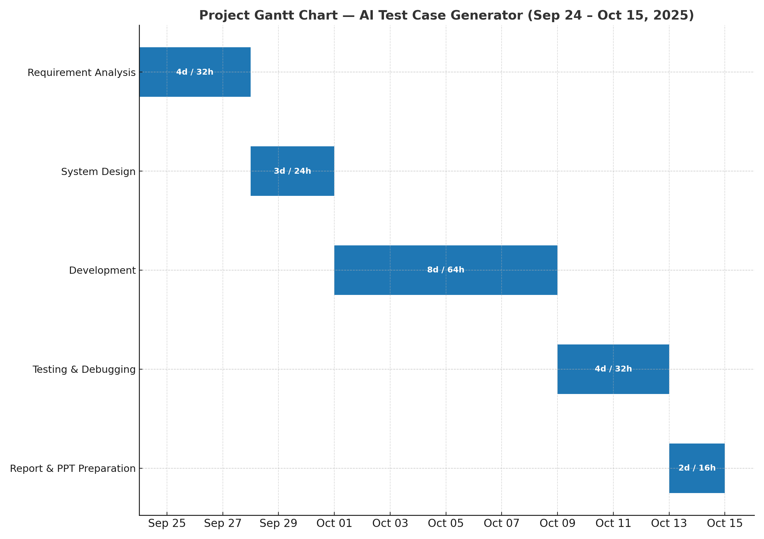
10. Project Time Spent (Phase-wise Breakdown)
h-> Hours

